Slide 1
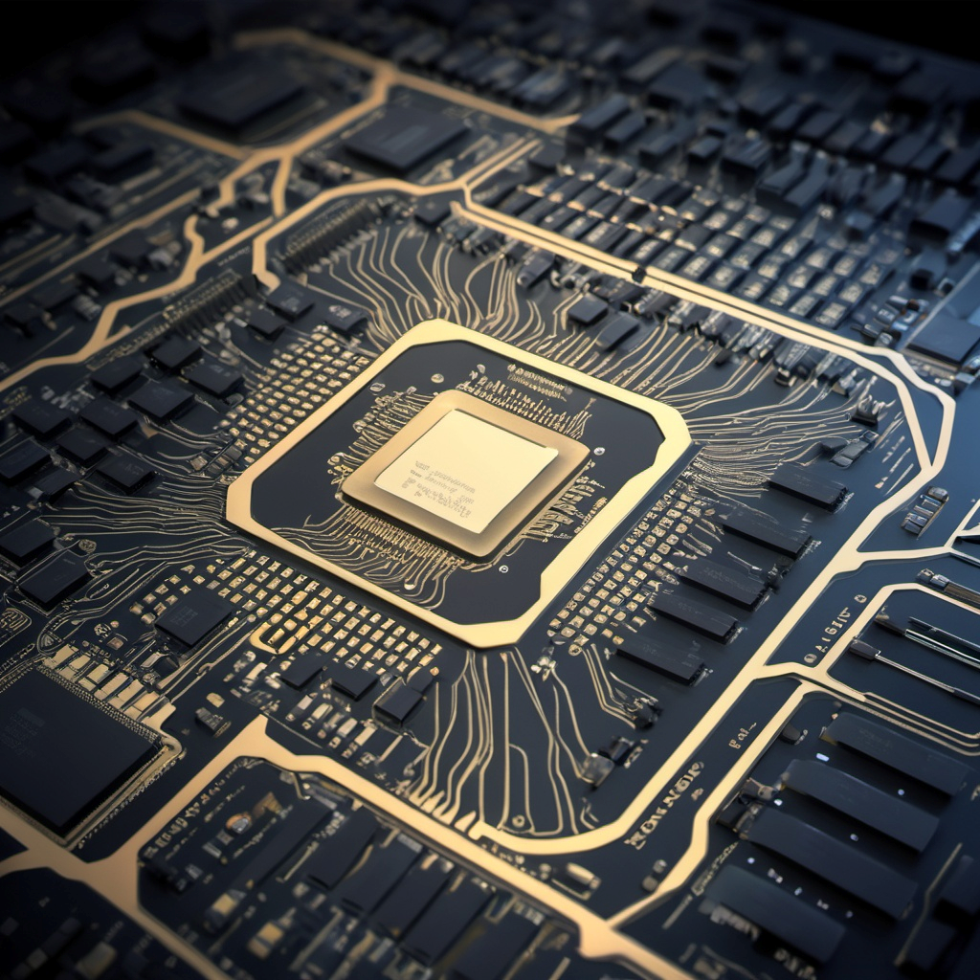
Approximate Computing
Academic Advisors:
Dr. Itamar Levi & Mr. Oren Ganon
Eliran Faridi & David Darvish

Slide 2

Motivation
Precise multiplication requires significant resources
Multiplying signed 16-bit numbers demands a large number of clock cycles, computational resources, and a high transistor count.
Energy and area savings
In a world where performance, energy efficiency, and reducing circuit area are crucial, there’s a need for solutions that reduce energy consumption and circuit size by minimizing the number of transistors.
Approximate Computing
Allows minimal precision loss in exchange for significant savings in energy, time, and resources. This is ideal for applications such as image processing and speech recognition.

Slide 3
Project goals
Development of an Approximate Multiplier
Develop a multiplier capable of performing multiplication for signed 16-bit numbers, while applying approximations based on the size of the numbers to save computational resources and circuit area.
Saving clock cycles, energy, and circuit area
Reduce the number of clock cycles required for multiplication operations, while significantly saving energy and reducing the circuit area.
Maintaining balance between accuracy and performance
The goal is to maintain reasonable accuracy for multiplication results while increasing computation speed, reducing energy consumption, and minimizing the required transistor count.

Slide 4
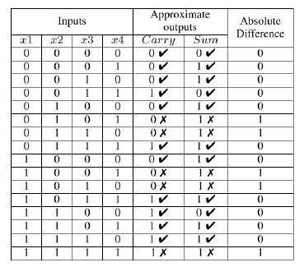
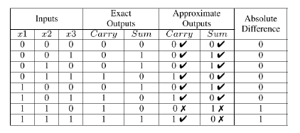
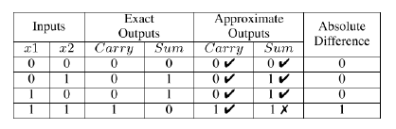
Truth tables
Approximate 4:2 Compressor
Approximate Full Adder
Approximate Half Adder

Slide 5
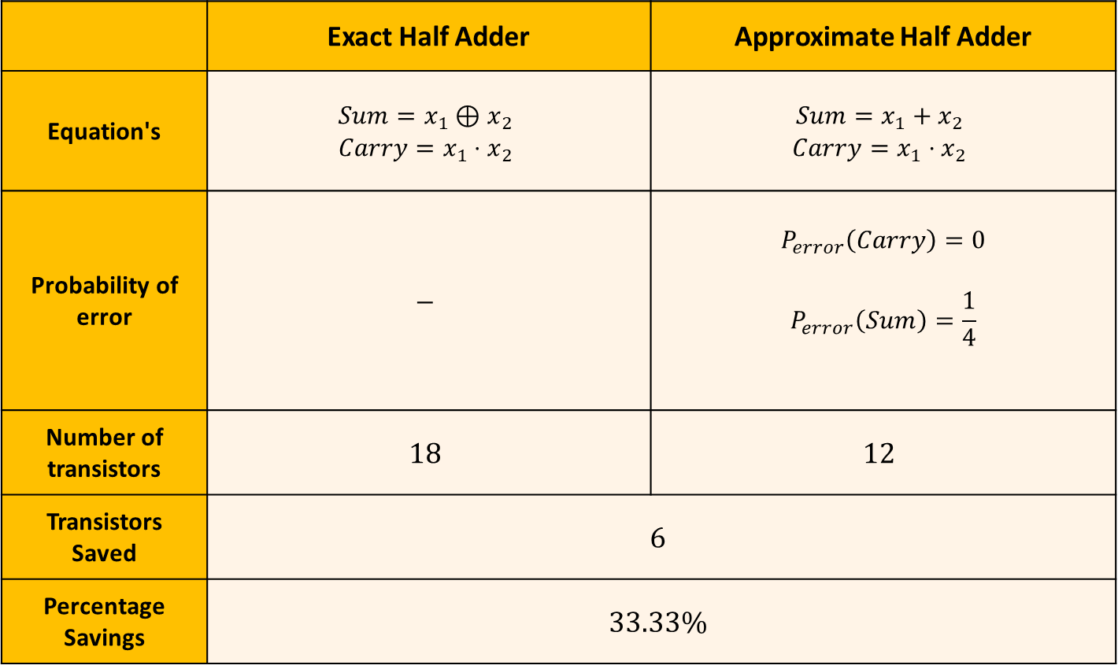
Exact Half Adder vs Approximate Half Adder
Approximate Half Adder | Exact Half Adder
$$Sum=x_{1}+x_{2}$$ $$Carry=x_{1}⋅x_{2}$$ | $$Sum=x_{1}⊕x_{2}$$ $$Carry=x_{1}⋅x_{2}$$ | Equation's
$$P_{error}\left(Carry\right)=0$$ $$P_{error}\left(Sum\right)=\frac{1}{4}$$ | $$−$$ | Probability of error
$$12$$ | $$18$$ | Number of transistors
$$6$$ |  | Transistors Saved
$$33.33\%$$ |  | Percentage Savings

Slide 6

Exact Full Adder vs Approximate Full Adder
Approximate Full Adder | Exact Full Adder
$$Sum=\left(x_{1}+x_{2}\right)⊕x_{3}$$ $$Carry=\left(x_{1}+x_{2}\right)⋅x_{3}$$ | $$Sum=x_{1}⊕x_{2}⊕x_{3}$$ $$Carry=x_{1}⋅x_{2}+\left(x_{1}⊕x_{2}\right)⋅x_{3}$$ | Equation's
$$P_{error}\left(Carry\right)=\frac{1}{8}$$ $$P_{error}\left(Sum\right)=\frac{2}{8}$$ | $$−$$ | Probability of error
$$24$$ | $$42$$ | Number of transistors
$$18$$ |  | Transistors Saved
$$42.85\%$$ |  | Percentage Savings

Slide 7
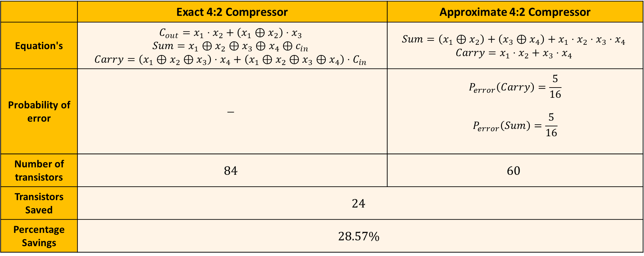
Exact 4:2 Compressor vs Approximate 4:2 Compressor
Approximate 4:2 Compressor | Exact 4:2 Compressor
$$Sum=\left(x_{1}⊕x_{2}\right)+\left(x_{3}⊕x_{4}\right)+x_{1}⋅x_{2}⋅x_{3}⋅x_{4}$$ $$Carry=x_{1}⋅x_{2}+x_{3}⋅x_{4}$$ | $$C_{out}=x_{1}⋅x_{2}+\left(x_{1}⊕x_{2}\right)⋅x_{3}$$ $$Sum=x_{1}⊕x_{2}⊕x_{3}⊕x_{4}⊕c_{in}$$ $$Carry=\left(x_{1}⊕x_{2}⊕x_{3}\right)⋅x_{4}+\left(x_{1}⊕x_{2}⊕x_{3}⊕x_{4}\right)⋅C_{in}$$ | Equation's
$$P_{error}\left(Carry\right)=\frac{5}{16}$$ $$P_{error}\left(Sum\right)=\frac{5}{16}$$ | $$−$$ | Probability of error
$$60$$ | $$84$$ | Number of transistors
$$24$$ |  | Transistors Saved
$$28.57\%$$ |  | Percentage Savings

Slide 8
Signed 8 bit x 8 bit approximate multiplication

Slide 9
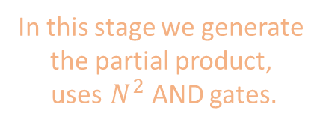
High Speed Multiplier Architectures
Partial Products Generator
In this stage we generate the partial product,
uses $N^{2}$ AND gates.
Reduction Tree
Final Adder

Slide 10
Partial Products Generator
Full Adders, Half Adders, and 4:2 Compressors are used to reduce the partial product tree column by column until only two rows remain.
Reduction Tree
Final Adder

Slide 11
Partial Products Generator
Reduction Tree
Final Adder
The final two rows of the partial product tree are added using a ripple carry adder to generate the final product.

Slide 12
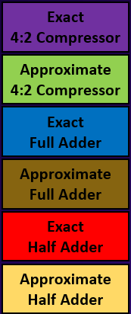
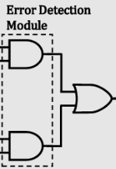
Approximate Multiplier Architecture
Exact Part
Approximate Part
Stage 1
compensate
Stage 2
Stage 3
Result

Slide 13
a0 | a1 | a2 | a3 | a4 | a5 | a6 | a7
 |  |  |  |  |  |  |  | x
b0 | b1 | b2 | b3 | b4 | b5 | b6 | b7
_____________________________________________

Slide 14
Generate Partial Product
a0 | a1 | a2 | a3 | a4 | a5 | a6 | a7
 |  |  |  |  |  |  |  | x
b0 | b1 | b2 | b3 | b4 | b5 | b6 | b7
_____________________________________________
b0a0 | b0a1 | b0a2 | b0a3 | b0a4 | b0a5 | b0a6 | b0a7
 | b1a0 | b1a1 | b1a2 | b1a3 | b1a4 | b1a5 | b1a6 | b1a7
 |  | b2a0 | b2a1 | b2a2 | b2a3 | b2a4 | b2a5 | b2a6 | b2a7
 |  |  | b3a0 | b3a1 | b3a2 | b3a3 | b3a4 | b3a5 | b3a6 | b3a7
 |  |  |  | b4a0 | b4a1 | b4a2 | b4a3 | b4a4 | b4a5 | b4a6 | b4a7
 |  |  |  |  | b5a0 | b5a1 | b5a2 | b5a3 | b5a4 | b5a5 | b5a6 | b5a7
 |  |  |  |  |  | b6a0 | b6a1 | b6a2 | b6a3 | b6a4 | b6a5 | b6a6 | b6a7
 |  |  |  |  |  |  | b7a0 | b7a1 | b7a2 | b7a3 | b7a4 | b7a5 | b7a6 | b7a7
Partial product

Slide 15
Exact
4:2 Compressor
Stage1 - Reduction Tree
Approximate 4:2 Compressor
a0 | a1 | a2 | a3 | a4 | a5 | a6 | a7
 |  |  |  |  |  |  |  | x
b0 | b1 | b2 | b3 | b4 | b5 | b6 | b7
_____________________________________________
b0a0 | b0a1 | b0a2 | b0a3 | b0a4 | b0a5 | b0a6 | b0a7
 | b1a0 | b1a1 | b1a2 | b1a3 | b1a4 | b1a5 | b1a6 | b1a7
 |  | b2a0 | b2a1 | b2a2 | b2a3 | b2a4 | b2a5 | b2a6 | b2a7
 |  |  | b3a0 | b3a1 | b3a2 | b3a3 | b3a4 | b3a5 | b3a6 | b3a7
 |  |  |  | b4a0 | b4a1 | b4a2 | b4a3 | b4a4 | b4a5 | b4a6 | b4a7
 |  |  |  |  | b5a0 | b5a1 | b5a2 | b5a3 | b5a4 | b5a5 | b5a6 | b5a7
 |  |  |  |  |  | b6a0 | b6a1 | b6a2 | b6a3 | b6a4 | b6a5 | b6a6 | b6a7
 |  |  |  |  |  |  | b7a0 | b7a1 | b7a2 | b7a3 | b7a4 | b7a5 | b7a6 | b7a7
Exact
Full Adder
Approximate Full Adder
0
Exact
Half Adder
Approximate Half Adder

Slide 16
Stage2 - Reduction Tree
b0a0 | b0a1 | b0a2 | b0a3 | s0 | c0 | c1 | c2 | c4 | c6 | c8 | c10 | c11 | b6a7 | b7a7
 | b1a0 | b1a1 | b1a2 | b2a2 | s1 | s2 | c3 | c5 | c7 | c9 | s11 | b5a7 | b7a6
 |  | b2a0 | b2a1 | b3a1 | b4a1 | s3 | s4 | s6 | s8 | s10 | b6a5 | b6a6
 |  |  | b3a0 | b4a0 | b5a0 | b6a0 | s5 | s7 | s9 | b7a3 | b7a4 | b7a5
a0 | a1 | a2 | a3 | a4 | a5 | a6 | a7
 |  |  |  |  |  |  |  | x
b0 | b1 | b2 | b3 | b4 | b5 | b6 | b7
_____________________________________________
compensate

Slide 17
Stage3 - Final Adder
a0 | a1 | a2 | a3 | a4 | a5 | a6 | a7
 |  |  |  |  |  |  |  | x
b0 | b1 | b2 | b3 | b4 | b5 | b6 | b7
_____________________________________________
b0a0 | b0a1 | s12 | c12 | c13 | c14 | c15 | c16 | c17 | c18 | c19 | c20 | c21 | c22 | c23
 | b1a0 | b2a0 | s13 | s14 | s15 | s16 | s17 | s18 | s19 | s20 | s21 | s22 | s23 | b7a7

Slide 18
Result
a0 | a1 | a2 | a3 | a4 | a5 | a6 | a7
 |  |  |  |  |  |  |  | x
b0 | b1 | b2 | b3 | b4 | b5 | b6 | b7
_____________________________________________
b0a0 | s24 | s25 | s26 | s27 | s28 | s29 | s30 | s31 | s32 | s33 | s34 | s35 | s36 | s37 | c37

Slide 19
Signed 16 bit x 16 bit approximate multiplication

Slide 20
Lets take two numbers of 16 bits.
We can calculate the multiplication like this:
Number1 = _ _ _ _ _ _ _ _ _ _ _ _ _ _ _ _ Number2 = _ _ _ _ _ _ _ _ _ _ _ _ _ _ _ _
Number1
Upper 8 bit
Number1
Lower 8 bit
Number2
Upper 8 bit
Number2
Lower 8 bit

Slide 21
Number1 = _ _ _ _ _ _ _ _ _ _ _ _ _ _ _ _ Number2 = _ _ _ _ _ _ _ _ _ _ _ _ _ _ _ _
Number1
Upper 8 bit
Number1
Lower 8 bit
Number2
Upper 8 bit
Number2
Lower 8 bit
Number1 x Number2 = x
Number1
Upper 8 bit
Number2
Upper 8 bit

Slide 22
Number1 = _ _ _ _ _ _ _ _ _ _ _ _ _ _ _ _ Number2 = _ _ _ _ _ _ _ _ _ _ _ _ _ _ _ _
Number1
Upper 8 bit
Number1
Lower 8 bit
Number2
Upper 8 bit
Number2
Lower 8 bit
Number1 x Number2 = x << 16
Number1
Upper 8 bit
Number2
Upper 8 bit

Slide 23
Number1 = _ _ _ _ _ _ _ _ _ _ _ _ _ _ _ _ Number2 = _ _ _ _ _ _ _ _ _ _ _ _ _ _ _ _
Number1
Upper 8 bit
Number1
Lower 8 bit
Number2
Upper 8 bit
Number2
Lower 8 bit
Number1 x Number2 = x << 16 + x
Number1
Upper 8 bit
Number2
Upper 8 bit
Number1
Upper 8 bit
Number2
Lower 8 bit

Slide 24
Number1 = _ _ _ _ _ _ _ _ _ _ _ _ _ _ _ _ Number2 = _ _ _ _ _ _ _ _ _ _ _ _ _ _ _ _
Number1
Upper 8 bit
Number1
Lower 8 bit
Number2
Upper 8 bit
Number2
Lower 8 bit
Number1 x Number2 = x << 16 + x << 8
Number1
Upper 8 bit
Number2
Upper 8 bit
Number1
Upper 8 bit
Number2
Lower 8 bit

Slide 25
Number1 = _ _ _ _ _ _ _ _ _ _ _ _ _ _ _ _ Number2 = _ _ _ _ _ _ _ _ _ _ _ _ _ _ _ _
Number1
Upper 8 bit
Number1
Lower 8 bit
Number2
Upper 8 bit
Number2
Lower 8 bit
Number1 x Number2 = x << 16 + x << 8 +
+ x
Number1
Upper 8 bit
Number2
Upper 8 bit
Number1
Upper 8 bit
Number2
Lower 8 bit
Number1
Lower 8 bit
Number2
Upper 8 bit

Slide 26
Number1 = _ _ _ _ _ _ _ _ _ _ _ _ _ _ _ _ Number2 = _ _ _ _ _ _ _ _ _ _ _ _ _ _ _ _
Number1
Upper 8 bit
Number1
Lower 8 bit
Number2
Upper 8 bit
Number2
Lower 8 bit
Number1 x Number2 = x << 16 + x << 8 +
+ x << 8
Number1
Upper 8 bit
Number2
Upper 8 bit
Number1
Upper 8 bit
Number2
Lower 8 bit
Number1
Lower 8 bit
Number2
Upper 8 bit

Slide 27
Number1 = _ _ _ _ _ _ _ _ _ _ _ _ _ _ _ _ Number2 = _ _ _ _ _ _ _ _ _ _ _ _ _ _ _ _
Number1
Upper 8 bit
Number1
Lower 8 bit
Number2
Upper 8 bit
Number2
Lower 8 bit
Number1 x Number2 = x << 16 + x << 8 +
+ x << 8 + x
Number1
Upper 8 bit
Number2
Upper 8 bit
Number1
Upper 8 bit
Number2
Lower 8 bit
Number1
Lower 8 bit
Number2
Upper 8 bit
Number1
Lower 8 bit
Number2
Lower 8 bit

Slide 28
Number1 = _ _ _ _ _ _ _ _ _ _ _ _ _ _ _ _ Number2 = _ _ _ _ _ _ _ _ _ _ _ _ _ _ _ _
Number1
Upper 8 bit
Number1
Lower 8 bit
Number2
Upper 8 bit
Number2
Lower 8 bit
Number1 x Number2 = x << 16 + x << 8 +
+ x << 8 + x
Number1 x Number2 = _ _ _ _ _ _ _ _ _ _ _ _ _ _ _ _ _ _ _ _ _ _ _ _ _ _ _ _ _ _ _ _
Number1
Upper 8 bit
Number2
Upper 8 bit
Number1
Upper 8 bit
Number2
Lower 8 bit
Number1
Lower 8 bit
Number2
Upper 8 bit
Number1
Lower 8 bit
Number2
Lower 8 bit
32 bit result

Slide 29
Difficulties and solutions

Slide 30

In the initial stages of our project, we encountered unexpectedly high error rates when comparing our estimated results to the exact outputs. The significant errors occurred mainly when handling lower numerical values ​​that are represented as 8-bit numbers, in the range of −256 𝑡𝑜 255.
$0 to 255$ numbers represented in binary like that:
00000000 _ _ _ _ _ _ _ _

Slide 31

$0 to 255$ numbers represented in binary like that:
00000000 _ _ _ _ _ _ _ _
Let's look at the seventh bit, and divide it into two cases.

Slide 32

$0 to 255$ numbers represented in binary like that:
00000000 _ _ _ _ _ _ _ _
If the seventh bit (marked in red) is 0, we will continue as usual.
00000000 0 _ _ _ _ _ _ _
Number
Upper 8 bit
Number
Lower 8 bit

Slide 33

$0 to 255$ numbers represented in binary like that:
00000000 _ _ _ _ _ _ _ _
If the seventh bit (marked in red) is 1
00000000 0 1 _ _ _ _ _ _ _
After performing the multiplication we will shift left by 1, to compensate the correction we made
Number
Upper 8 bit
Number
Lower 8 bit

Slide 34

$−256 to 0$ numbers represented in binary like that:
11111111 _ _ _ _ _ _ _ _

Slide 35

$−256 to 0$ numbers represented in binary like that:
11111111 _ _ _ _ _ _ _ _
Let's look at the seventh bit, and divide it into two cases.

Slide 36

$−256 to 0$ numbers represented in binary like that:
11111111 _ _ _ _ _ _ _ _
If the seventh bit (marked in red) is 1, we will continue as usual.
11111111 1 _ _ _ _ _ _ _
Number
Upper 8 bit
Number
Lower 8 bit

Slide 37

$−256 to 0$ numbers represented in binary like that:
11111111 _ _ _ _ _ _ _ _
If the seventh bit (marked in red) is 0
11111111 1 0 _ _ _ _ _ _ _
After performing the multiplication we will shift left by 1, to compensate the correction we made
Number
Upper 8 bit
Number
Lower 8 bit

Slide 38



The number in range $[−256 , 255]$
The number in range $[−256 , 0]$
The number in range $[0 , 255]$
The seventh bit is 1
The seventh bit is 0
The seventh bit is 1
The seventh bit is 0
Shift left by 1 after multiplication
Continue as usual
Continue as usual
Shift left by 2 after multiplication

Slide 39
Acceleration

Slide 40

Another goal was to achieve acceleration, we aimed to maximize the number of calculations that could be performed within a single clock cycle. We work with AR registers (32-bit) and to utilize all the bits in the register we take the two 16-bit numbers and built with them a 32-bit number
The construction of the number is performed as follows:
$$32_bit_number =(num1 << 16) | (num2 \& 0xFFFF);$$
This way we can multiply four 16-bit numbers in one clock cycle, and as a result reduce the number of cycles by half compared to a normal multiplier (Achieved 50% improvement).

Slide 41
For example, if we do 100 iterations, after profiling we got:
Size (bytes) | Called | Total (F+C) | Children (C) | Function | Function Name
9 | 100 | 500 | 0 | 500 | approximate_multiplication_TIE
12 | 200 | 1,000 | 0 | 1,000 | multiplication_C

Slide 42
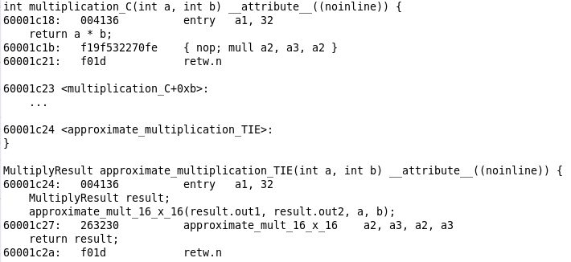
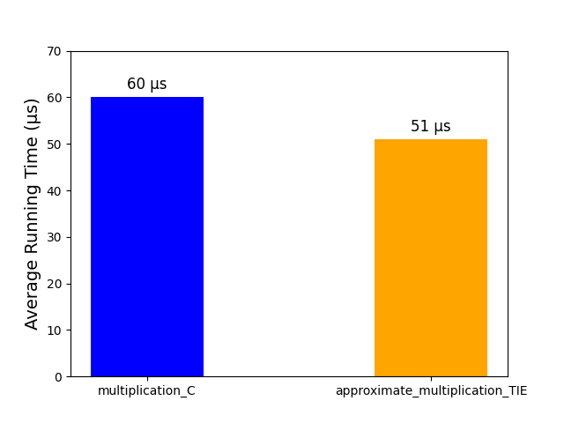
Run time improved, we achieved 15% improvement

Slide 43
Results

Slide 44
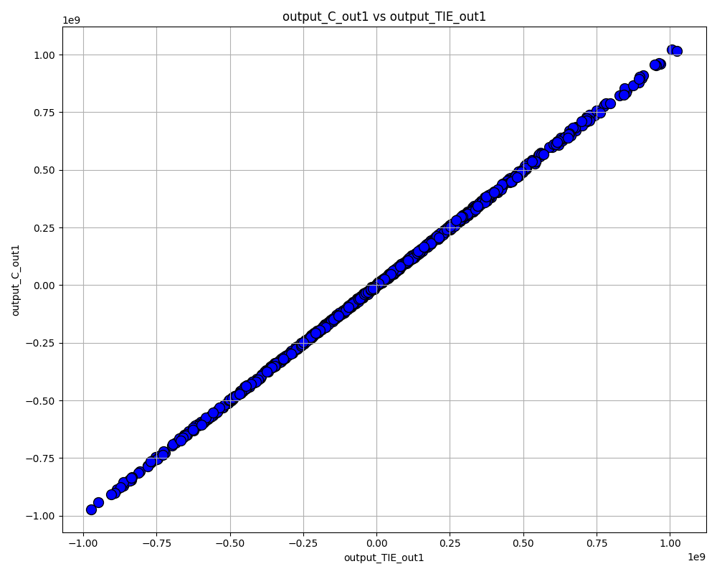
The plot shows a near-linear correlation between exact and approximate product values, indicating high accuracy.

Slide 45
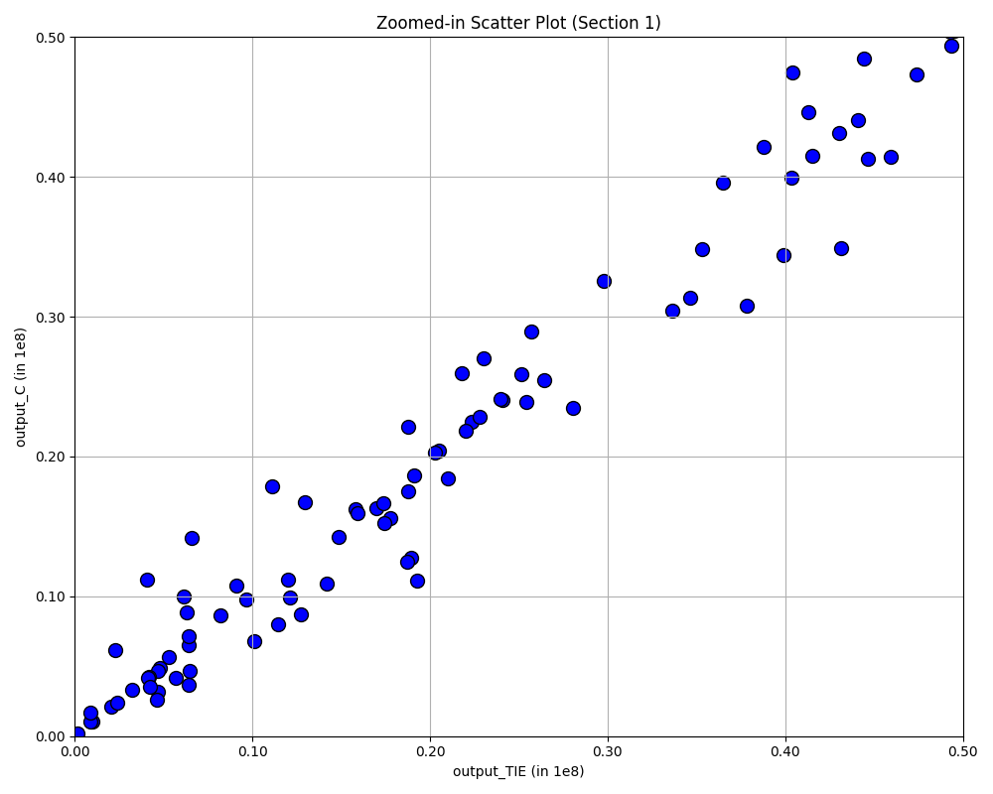
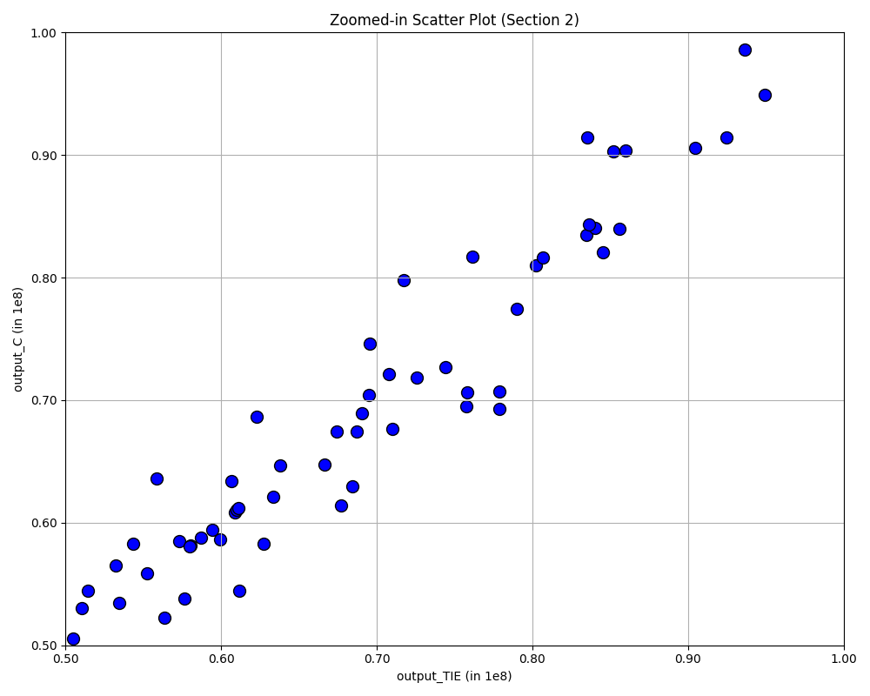
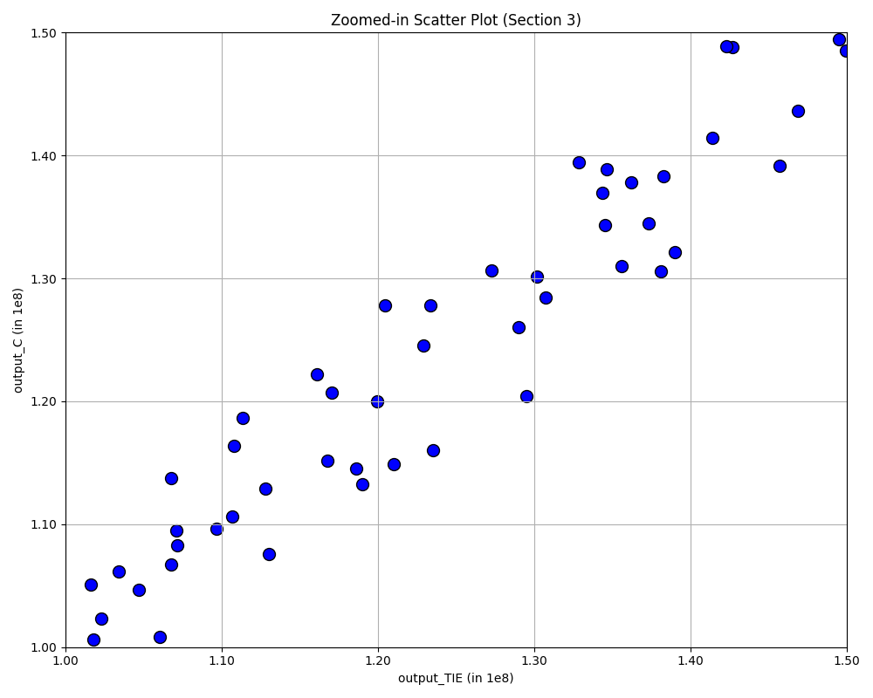
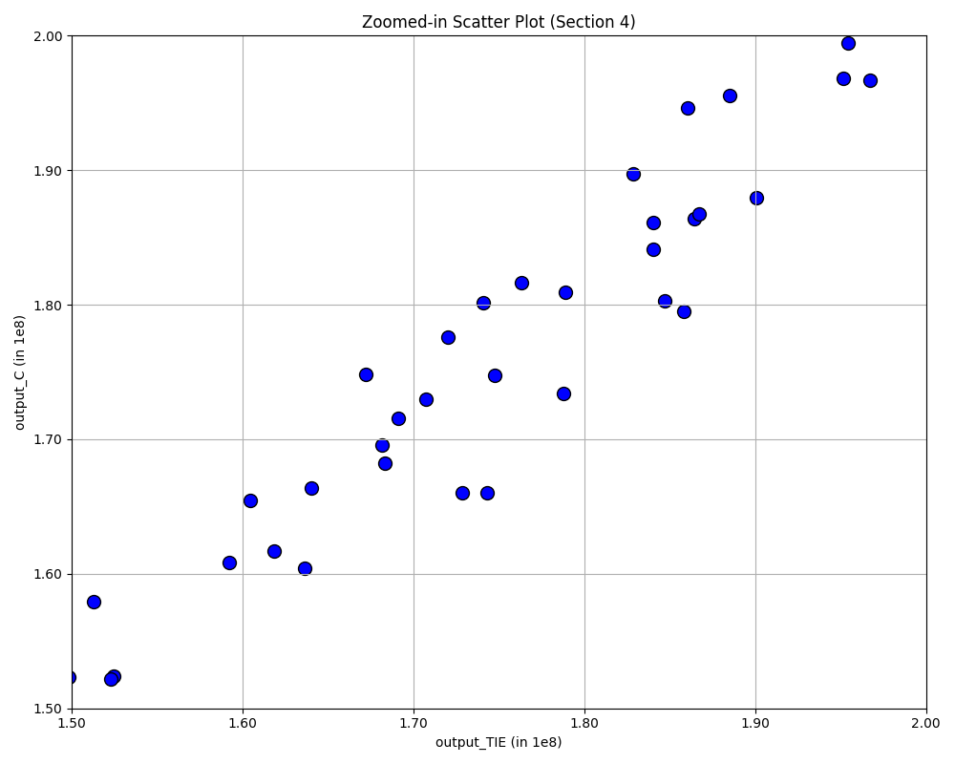

Slide 46
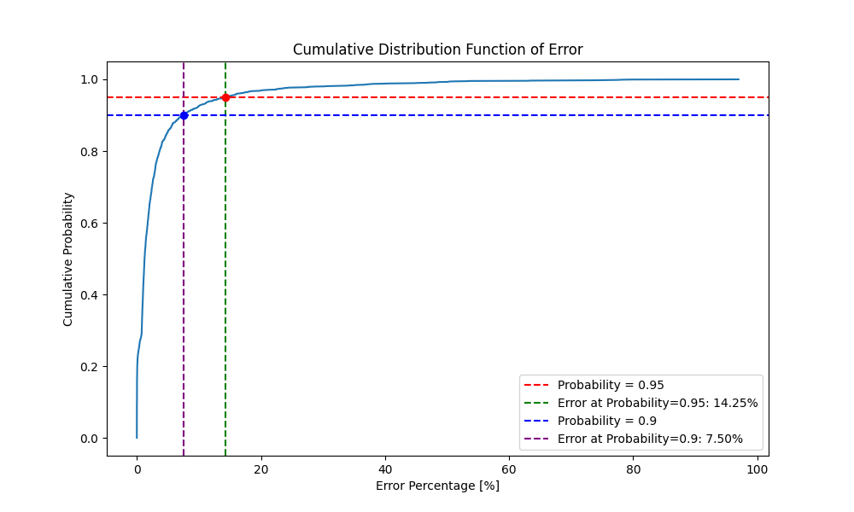

CDF graph shows that most errors are small, with a sharp rise up to ~15%, indicating few large errors beyond this range.
$$Number2$$ | $$Number1$$ | $$Error Percentage (\%)$$
$$−11426$$ | -$264$ | $$96.97$$
$$29500$$ | $$−319$$ | $$79.71$$
$$13844$$ | $$−328$$ | $$78.05$$
$$−7460$$ | $$−348$$ | $$77.63$$
$$−10248$$ | $$−354$$ | $$76.17$$
$$−32313$$ | $$−343$$ | $$73.95$$
$$27604$$ | $$405$$ | $$63.39$$
$$29780$$ | $$477$$ | $$53.67$$
$$−23611$$ | $$−528$$ | $$50.08$$
$$−23347$$ | $$−546$$ | $$48.48$$
$$−15847$$ | $$−547$$ | $$46.8$$
$$15470$$ | $$−559$$ | $$44.84$$
$$−7352$$ | $$−631$$ | $$39.78$$
$$−6313$$ | $$684$$ | $$36.67$$
$$−12970$$ | $$−840$$ | $$30.48$$
$$9413$$ | $$941$$ | $$28.79$$
$$11151$$ | $$−855$$ | $$26.04$$
$$−32139$$ | $$−1085$$ | $$23.78$$
$$−27586$$ | $$−1117$$ | $$22.86$$

Slide 47
CDF graph shows that most errors are small, with a sharp rise up to ~15%, indicating few large errors beyond this range.
$$Number2$$ | $$Number1$$ | $$Error Percentage (\%)$$
$$−11426$$ | -$264$ | $$96.97$$
$$29500$$ | $$−319$$ | $$79.71$$
$$13844$$ | $$−328$$ | $$78.05$$
$$−7460$$ | $$−348$$ | $$77.63$$
$$−10248$$ | $$−354$$ | $$76.17$$
$$−32313$$ | $$−343$$ | $$73.95$$
$$27604$$ | $$405$$ | $$63.39$$
$$29780$$ | $$477$$ | $$53.67$$
$$−23611$$ | $$−528$$ | $$50.08$$
$$−23347$$ | $$−546$$ | $$48.48$$
$$−15847$$ | $$−547$$ | $$46.8$$
$$15470$$ | $$−559$$ | $$44.84$$
$$−7352$$ | $$−631$$ | $$39.78$$
$$−6313$$ | $$684$$ | $$36.67$$
$$−12970$$ | $$−840$$ | $$30.48$$
$$9413$$ | $$941$$ | $$28.79$$
$$11151$$ | $$−855$$ | $$26.04$$
$$−32139$$ | $$−1085$$ | $$23.78$$
$$−27586$$ | $$−1117$$ | $$22.86$$

Slide 48
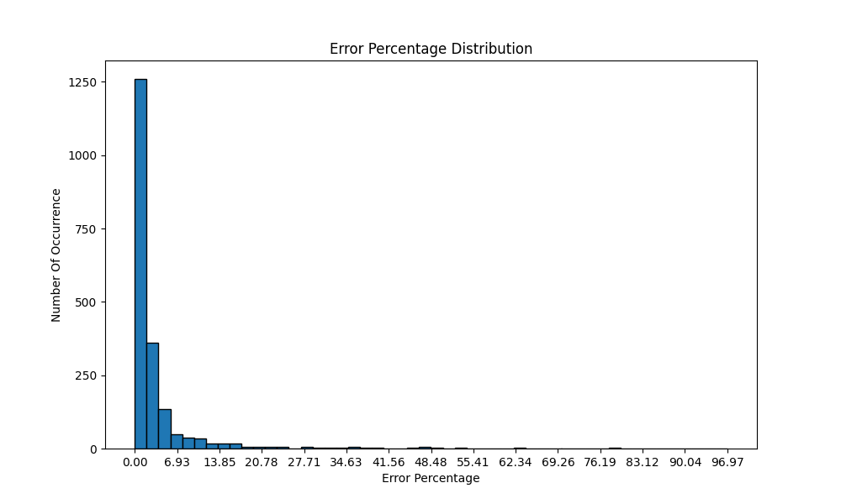
The graph displays a distribution of error percentages, with most data showing minimal error around 0% and a sharp drop-off in frequency as error percentages increase.

Slide 49
Thank you!

